Slide 1
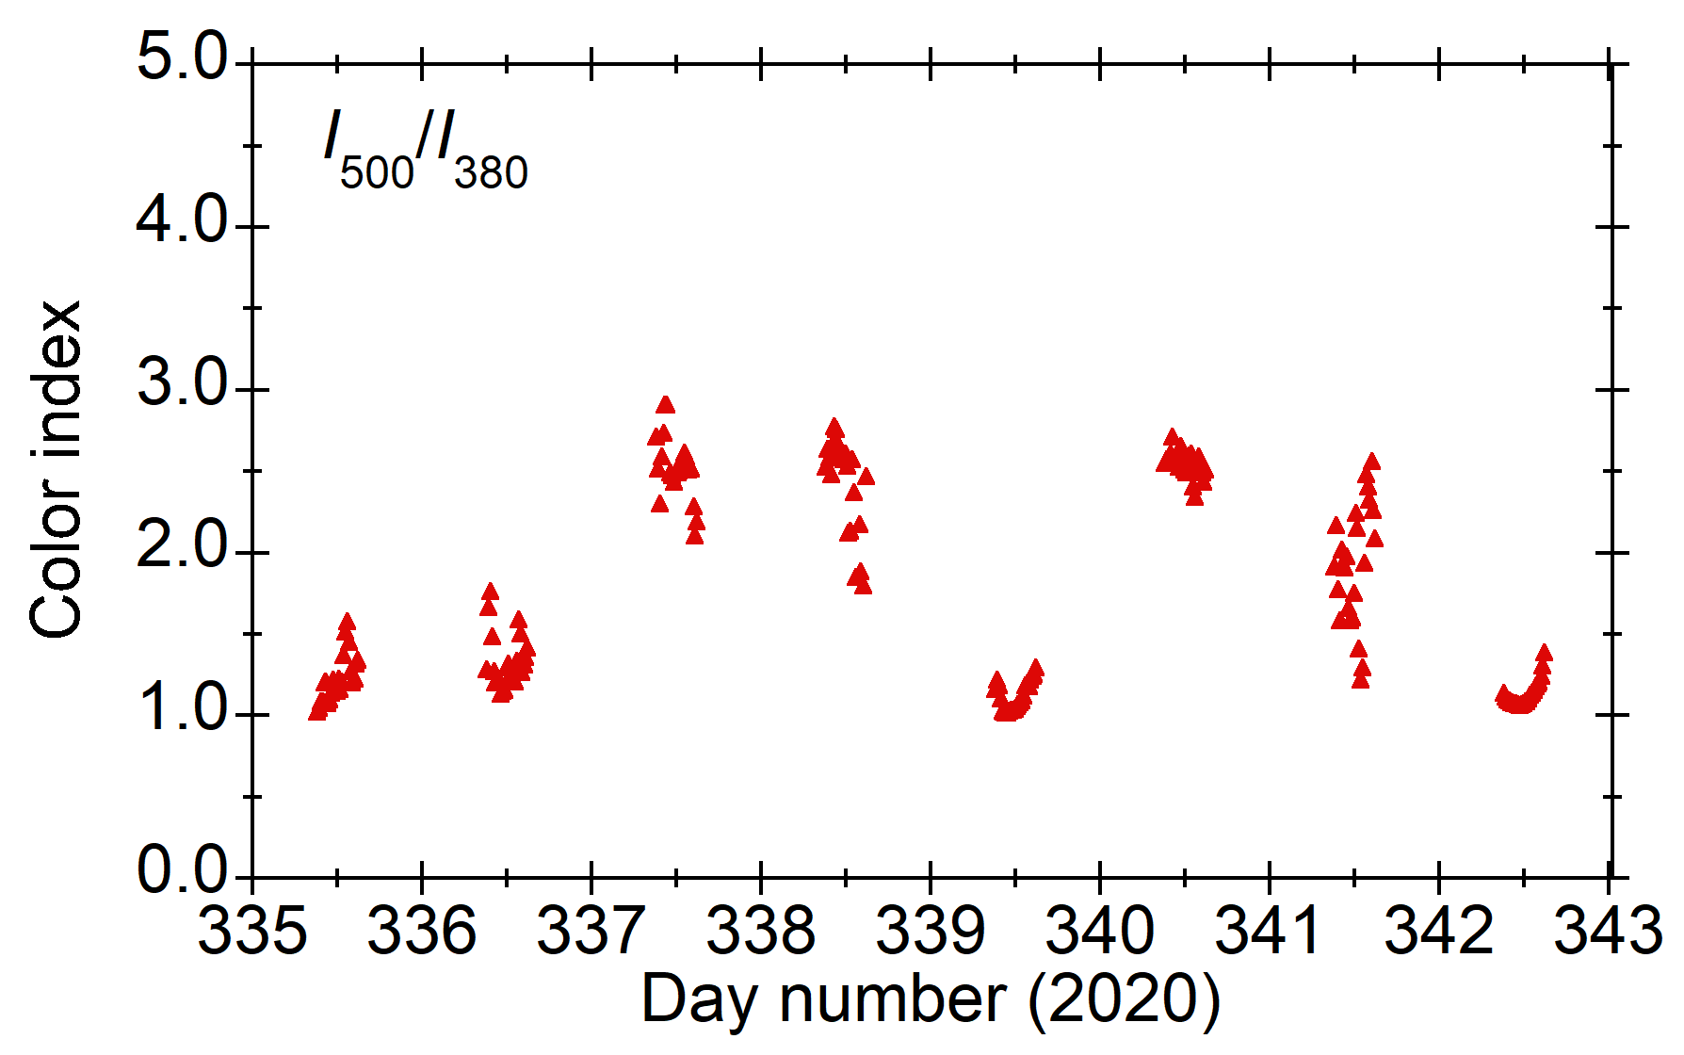
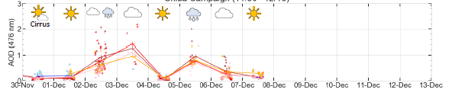
Color index as cloud information
sky is white
MAX-DOAS #1 (north)
sky is blue
Ohno-kun’s plot

Slide 2
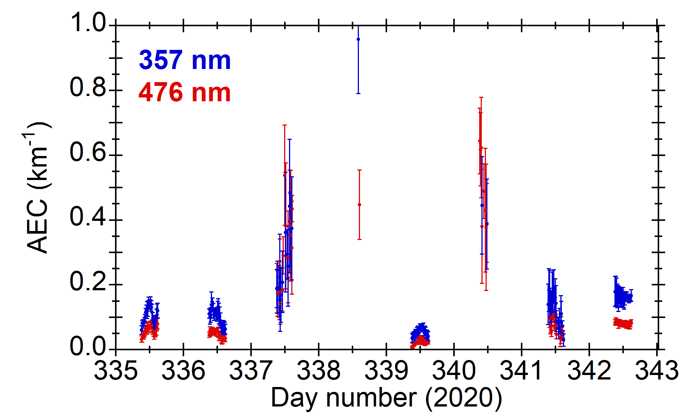
Aerosol extinction coefficient
MAX-DOAS #1 (north)

